Slide 1
FRC 4662 Programming
Who What When Why (HOW Later)

Slide 2
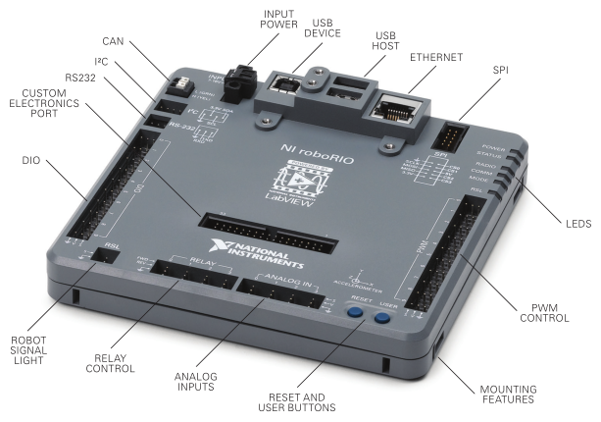
Roborio
National Instruments
ARM processor
Linux
Custom for FIRST

Slide 3
Languages
Labview – National Instruments (proprietary)
4662 used this the first two years
Drag-n-drop icons for objects
“Wire” together to control data and decision flow
Provided Driver Station and some RoboRIO utility code are in Labview
Java – Sun 1995 (now Oracle)
4662 on its third year now C++ - http://www.cplusplus.com/info/history/
used on Arduino – runs the LED string on the Competition Robot
Python – unofficial and volunteer supported
https://robotpy.github.io/projects/
FIRST Sponsor WPI (Worchester Polytechnic Institute)
Robotics program participates in DARPA challenge events
Has interns (grad students) write FIRST libraries for Java and C++
Java documentation http://first.wpi.edu/FRC/roborio/release/docs/java/
Hosts a lot of FIRST training material like this https://wpilib.screenstepslive.com/s/4485

Slide 4
Summer Learning - Test Robot Electronics
Goals
Learn PID control coding mechanisms
Work on OO and Better Practices
Actuators
Motors and gearboxes for drive system
Linear Actuator (motorized screw jack)
Speed Controllers
Talon SRX (CTRE)
Talon (now obsolete, available as a discontinued item)
Sensors
Quadrature Encoder
reads rotation speed, distance, and direction
http://www.digikey.com/product-detail/en/AMT102-V/102-1307-ND/827015
Potentiometer
reads position on a rotary scale
can be adapted to a linear scale with a “string” potentiometer
amazon.com search on linear potentiometer 10k
Limit Switches
AndyMark
http://www.andymark.com/

Slide 5
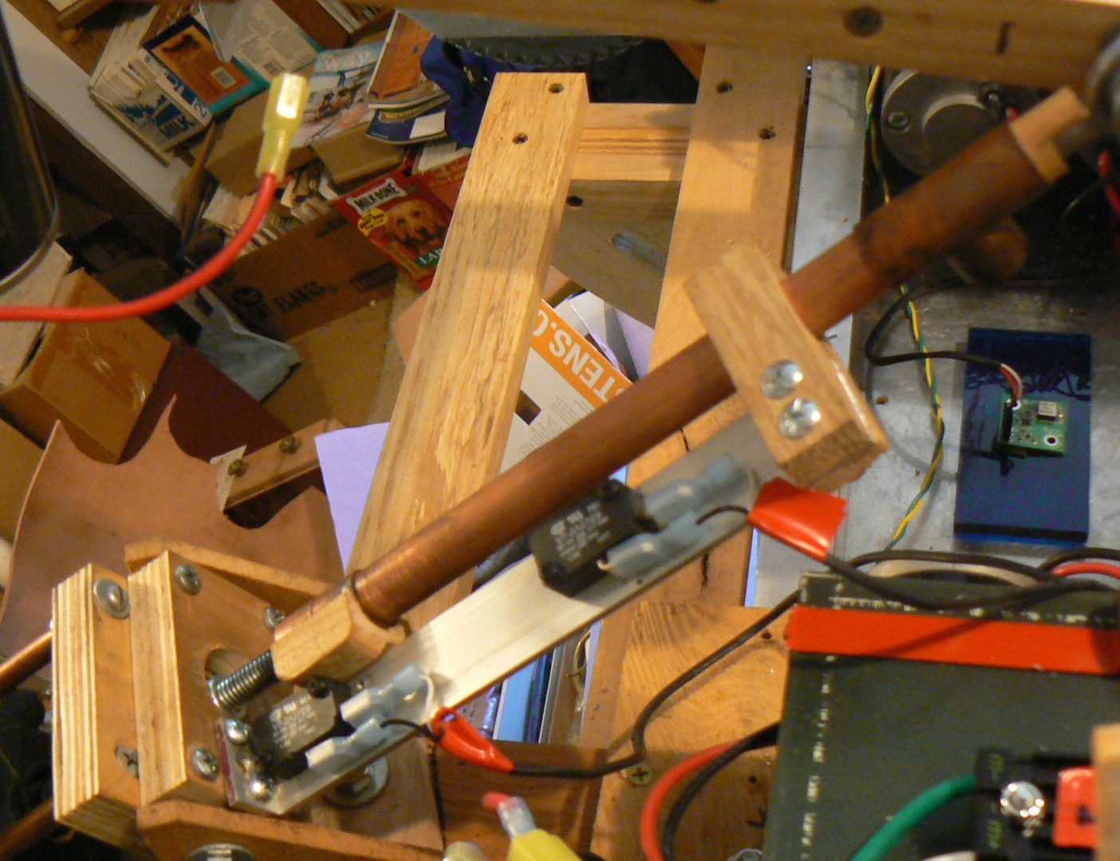
ARM LIFT
“Linear Actuator” home built version
AndyMark Snowblower Motor
All-thread (3/8”)
Misc plumbing parts
Potentiometer
Limit Switches
Also pictured – Gyroscope for Drive System

Slide 6
Actuator - ARmSystem
Command Based
Adopts some “Best Practices” seen in other team’s code samples (NUTRONS)
Java Class Encapsulation Example
An Object is a “thing”
A Class can “blueprint” a “thing”
PID Controller using Potentiometer
Proportional, Integral, Derivative – the theory is a whole topic
Needs work aka Exercises
Initialize routine to save “home” position
Fix the OnTarget method to tie limit switch detection to movement direction
Allow updates to Target Table (e.g. a Save Setpoint command)
Use true/false for table increment command rather than hard-code
Read/Write Setpoint table from RoboRIO stored file

Slide 7
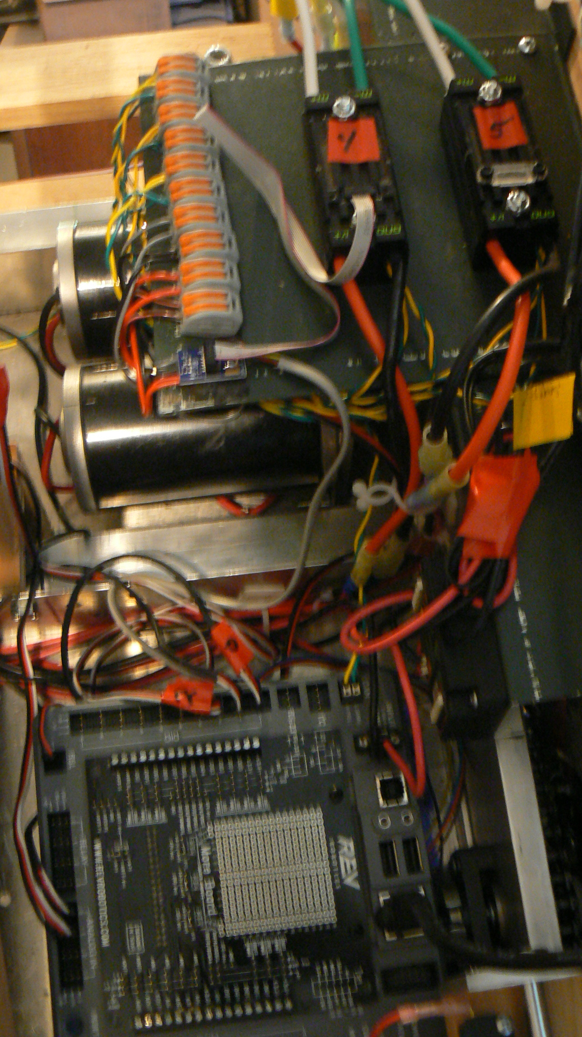
Drive system
RoboRIO
Talon SRX with Encoder and Limit Switch Breakout board
2 CIM Drive
Gearbox

Slide 8
Drive - PIDLing2gyro
Command Based
Pre “Best Practices” (as delivered from FRC provided RobotBuilder)
PID Encoder control using Talon SRX connected on Right side drive
Gyro read – not incorporated into drive
Needs Work – More Exercises
PID Encoder control of both Left and Right drive for distance
PID Gyro control of Left and Right drive for heading (self-steering)
HINT – Nutron code base does this and a lot more (link from Chief Delphi to Github)
isStuck/inTrouble methods
Got Stuck? Handle overloads / drive errors for autonomous

Slide 9
Shopping
AndyMark http://www.andymark.com/Default.asp
FRC major supplier
Cross The Road Electronics http://www.ctr-electronics.com/
FRC custom electronics
VEX Robotics http://www.vexrobotics.com/vexpro
FRC drive parts and electronics
Digi-key http://www.digikey.com/en
electronics and connectors (voucher)
Mouser http://www.mouser.com/
electronics and connectors
Amazon http://amazon.com
learn to search (potentiometers, bearings, rod ends, etc.)
eBay http://ebay.com
learn to search (linear actuators, Anderson powerpole, etc.)
Hansen Hobbies http://www.hansenhobbies.com/
bulk PWM cable parts
Surplus Gizmos http://www.surplusgizmos.com/
surplus electronics and tech parts shop in Hillboro (on Cornelius Pass Road)

Slide 10
References
FIRST http://www.firstinspires.org/robotics/frc
Oregon FIRST http://oregonfirst.org/
National Instrumets https://decibel.ni.com/content/community/academic/student_competitions/frc
Chief Delphi (FRC Discussion Forum) https://www.chiefdelphi.com/forums/index.php
FRC 2016 Control System https://wpilib.screenstepslive.com/s/4485
Java Training http://docs.oracle.com/javase/tutorial/
Java Docs http://docs.oracle.com/javase/8/docs/api/
Java WPILib http://first.wpi.edu/FRC/roborio/release/docs/java/
Eclipse https://eclipse.org/
Github https://github.com/

